Slide 1

Version Control and GitHub
GitHub Workshop Day 2
Cassandra Hui
26 November 2024

Slide 2
AGENDA
Recap
Branching
Hands-On: Making a branch
GitHub Pages
Hands-On: Make your own website

Slide 3
Recap
Version control (Git) is a system for tracking changes to files over time, allowing you to:
Collaborate with others on the same project.
Keep a history of changes to revert to earlier versions if needed.
GitHub is a platform that hosts Git repositories online and makes collaboration easy.
Repositories: Store your code, track changes, and collaborate.
Commit: A snapshot of changes, saved with a message describing what was updated.

Slide 4



Remote Location
Emily's Computer
Remote
Project
Raw Data
Stats.R
README.md

Slide 5
Remote Location
Emily's Computer
Remote
Project
Raw Data
Stats.R
README.md
Commit

Slide 6
Remote Location
Emily's Computer
Remote
Project
Raw Data
Stats.R
README.md
Clone

Slide 7
Remote Location
Emily's Computer
Remote
Editing stats script
Writing manuscript
Project
Raw Data
Stats.R
README.md
Clone

Slide 8
Remote Location
Emily's Computer
Remote
Project
Raw Data
Stats.R (v2)
Commit
Push
README.md
Clone
Manuscript

Slide 9
Remote Location
Emily's Computer
Remote
Project
More work
Raw Data
Stats.R (v2)
Push
README.md
Clone
Manuscript

Slide 10
Collaboration
Cloning Repositories: Collaborators can clone a repository to their local computer, allowing them to work on the project offline and make changes.
Making Changes Locally: After cloning, collaborators can edit files, save their changes, and commit them to track progress.
Pushing Changes: Once changes are committed locally, collaborators can push them to the shared repository on GitHub to update the project.
Syncing Updates: Collaborators can pull updates from the repository to ensure they have the latest version of the project files.

Slide 11
Remote Location – Collaboration
Emily's Computer
Remote

Slide 12
Remote Location – Collaboration
Emily's Computer
Remote
Commit

Slide 13
Remote Location – Collaboration
Emily's Computer
Remote
Clone

Slide 14

Remote Location – Collaboration
Emily's Computer
Remote
Bob's Computer
Clone

Slide 15
Remote Location – Collaboration
Emily's Computer
Remote
Bob's Computer
Clone
Clone

Slide 16
Remote Location – Collaboration
Emily's Computer
Remote
Bob's Computer
Clone
Clone

Slide 17
Remote Location – Collaboration
Emily's Computer
Remote
Bob's Computer
Push
Commit
Clone
Clone

Slide 18
Remote Location – Collaboration
Emily's Computer
Remote
Bob's Computer
Pull
Push
Clone
Clone

Slide 19
Remote Location – Collaboration
Emily's Computer
Remote
Bob's Computer
Pull
Push
Clone
Clone

Slide 20
Remote Location – Collaboration
Emily's Computer
Remote
Bob's Computer
Push
Pull
Push
Clone
Clone

Slide 21
Remote Location – Collaboration
Emily's Computer
Remote
Bob's Computer
Updated Project
Pull
Push
Pull
Push
Clone
Clone

Slide 22
Remote Location – Collaboration
Emily's Computer
Remote
Bob's Computer
More work
Pull
Push
Pull
Push
Clone
Clone

Slide 23
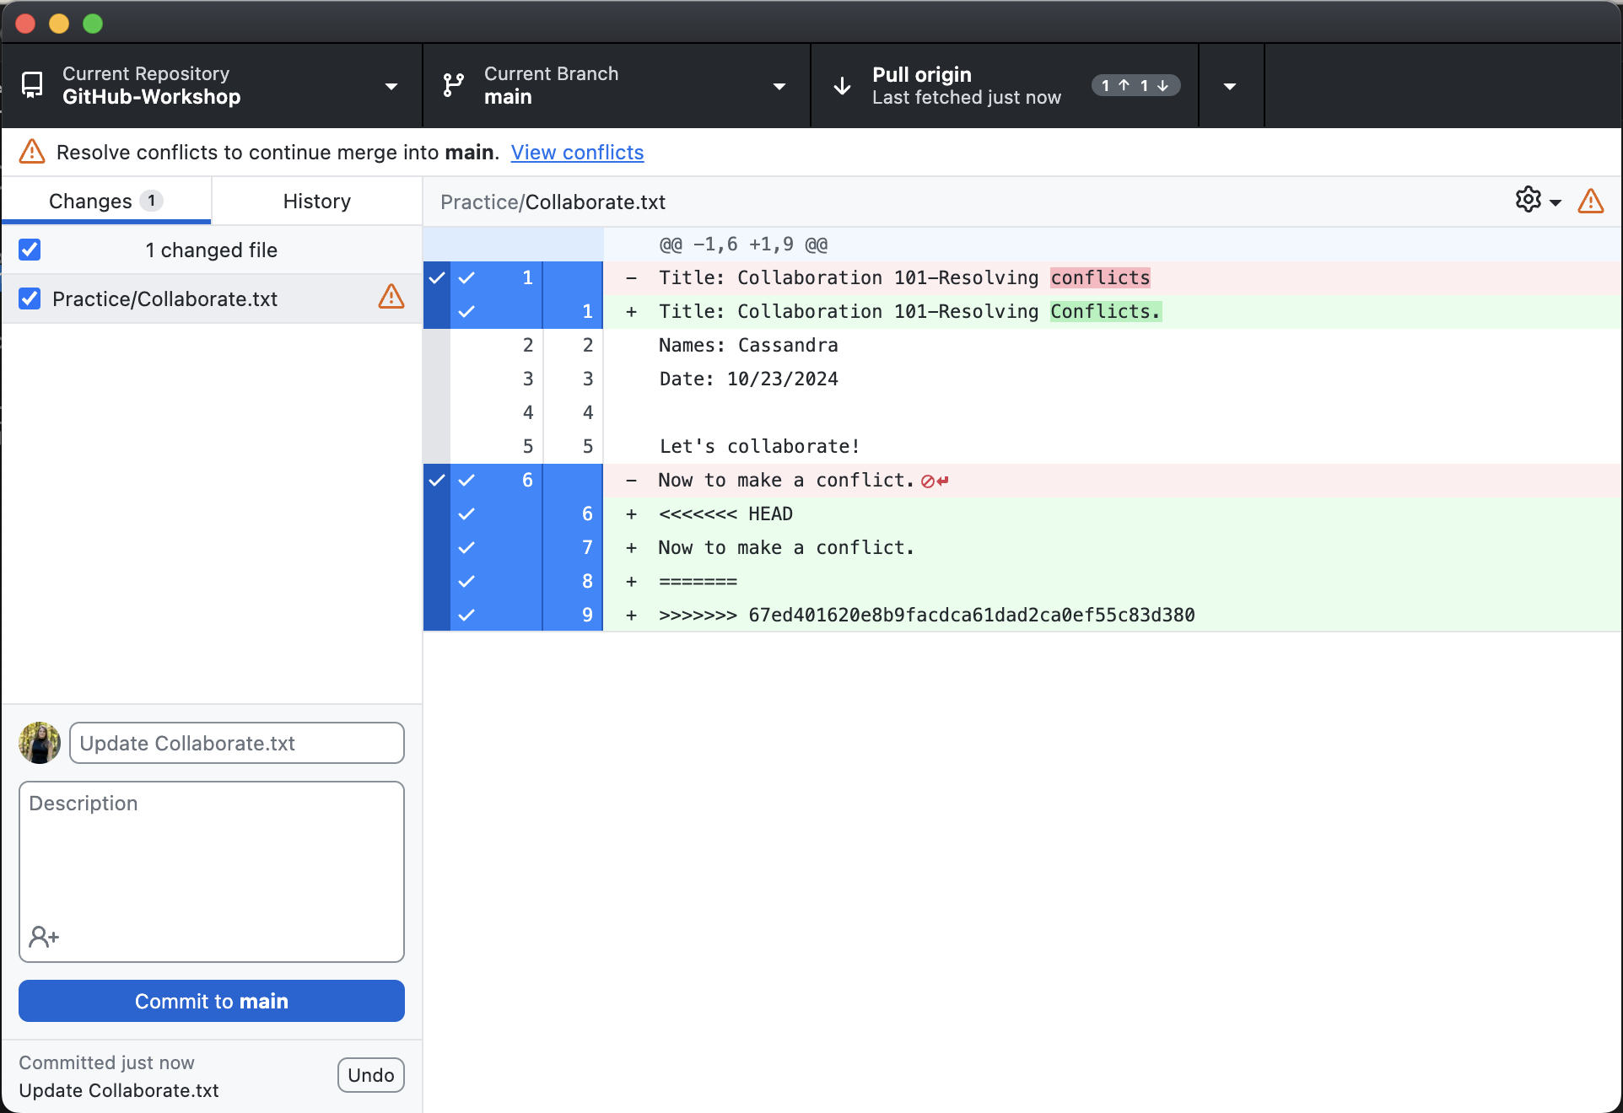
Resolving Conflicts
What Are Conflicts?
Conflicts happen when two people make changes to the same part of a file in a repository and Git cannot automatically decide which change to keep.
How to Resolve Conflicts?
Git shows you the conflicting sections, and you decide how to combine the changes.
Conflicts are resolved locally (on your computer) or online (on GitHub, using the conflict editor).

Slide 24
Cloning Other Repositories
Cloning creates a local copy of a repository on your computer, allowing you to view, edit, and work with the files offline without affecting the original repository.

Slide 25
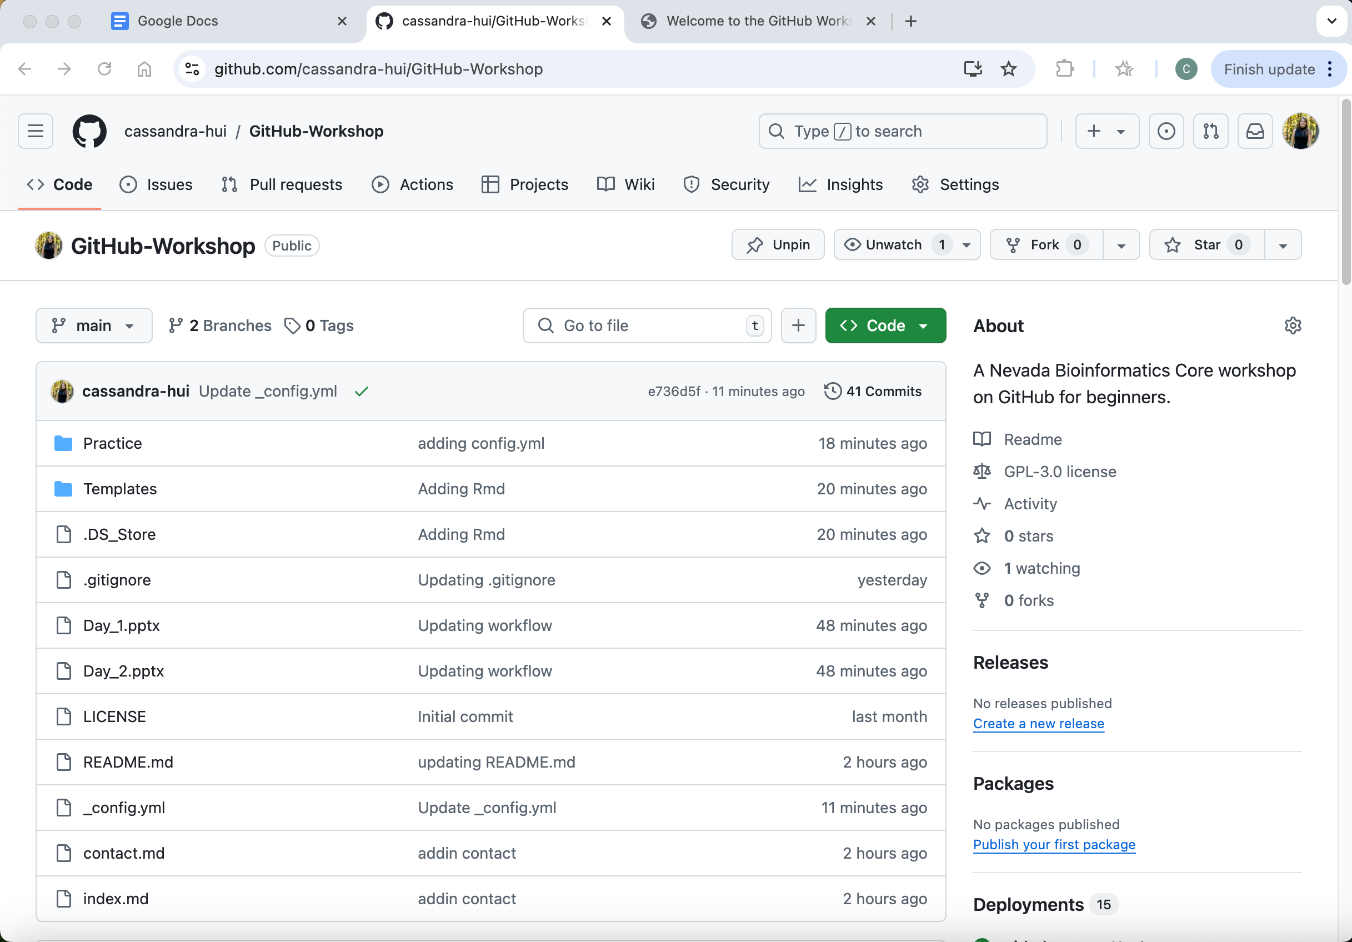
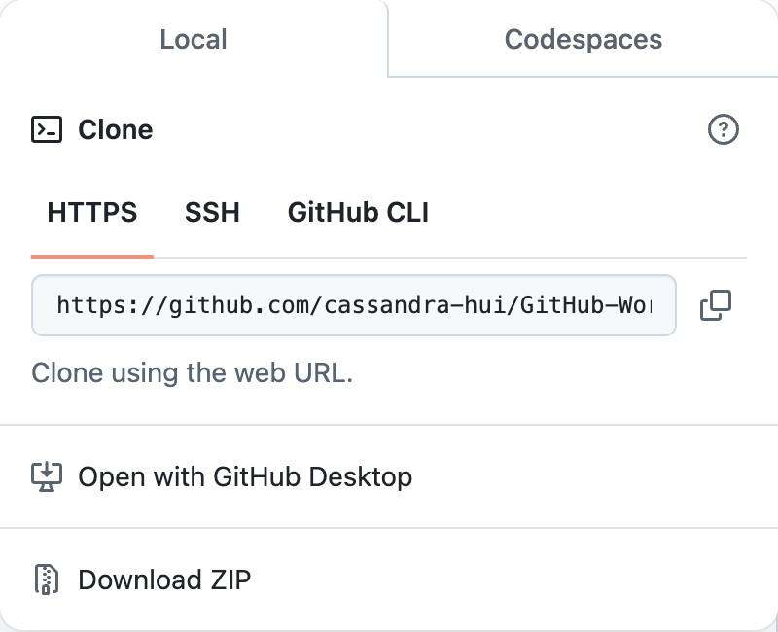

Slide 26
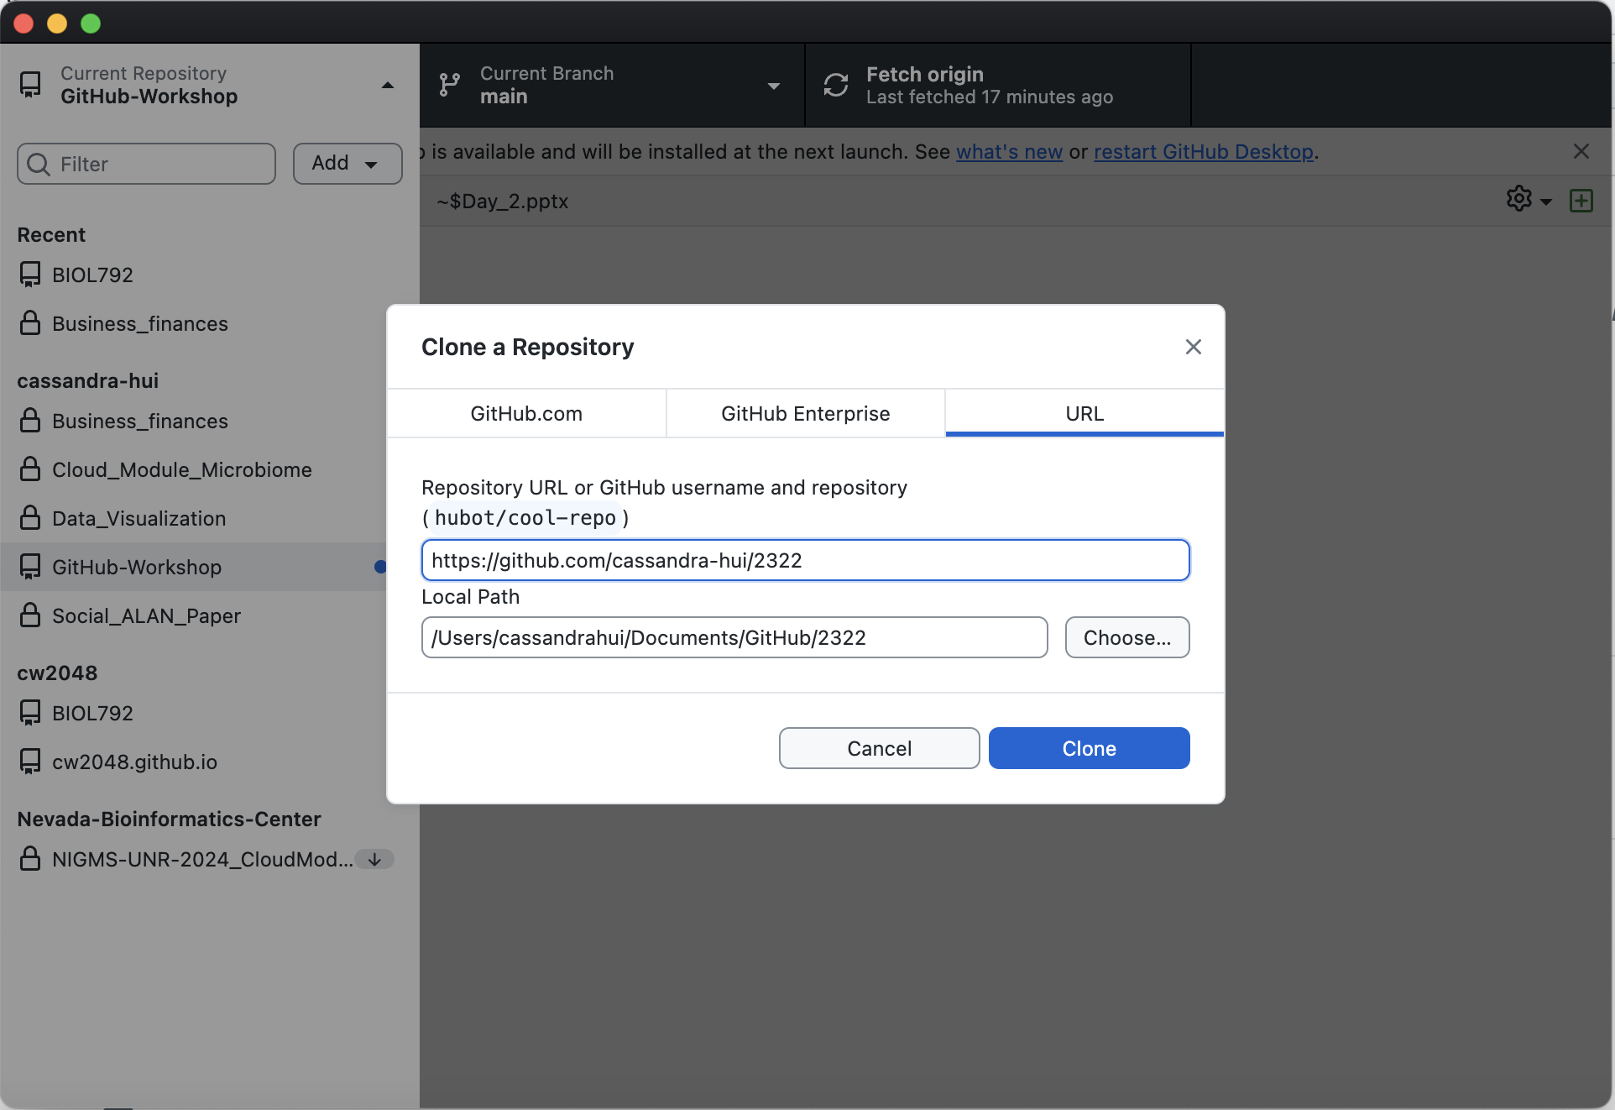

Slide 27

BRANCHING
What is Branching?
Branching is a way to create a separate version of your project within the same repository.
It allows you to work on new features, fix bugs, or experiment without affecting the main (production) version of your code.
The main branch (sometimes called master) is the default branch created and is typically the stable version of the project.

Slide 28
Why Use Branching?
Keeps the main branch stable and clean while allowing for parallel development.
Enables collaboration by allowing multiple team members to work on different branches simultaneously.
Helps avoid conflicts by isolating changes in dedicated branches.

Slide 29
How to Use Branching
• When you create a branch, Git duplicates the current state of the repository into the new branch.
• You can switch between branches to work on different versions of the project.
• Once the changes in a branch are complete, you can merge them back into the main branch.

Slide 30
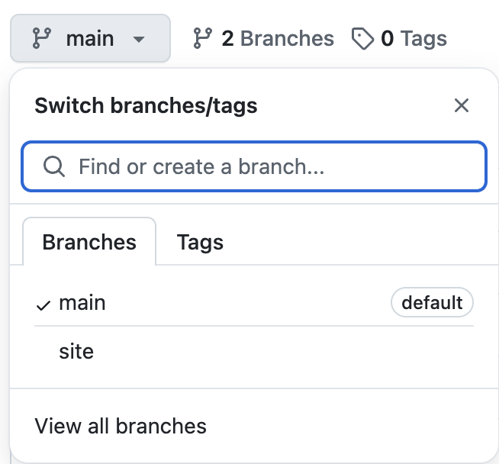
Workflow
Create a branch: Create a new branch for each feature, bug fix, or experiment.
Make changes: Work on the new branch without impacting the main branch.
Merge the branch: Once your changes are complete and tested, merge the branch into the main branch.
Delete the branch: After merging, you can delete the branch to keep your repository clean.

Slide 31
Branching
Follow the 4_branching.md file in the Practice folder
Create a branch and make edits
Create a pull request and merge with the main
Delete a branch

Slide 32
Create a Branch

Slide 33
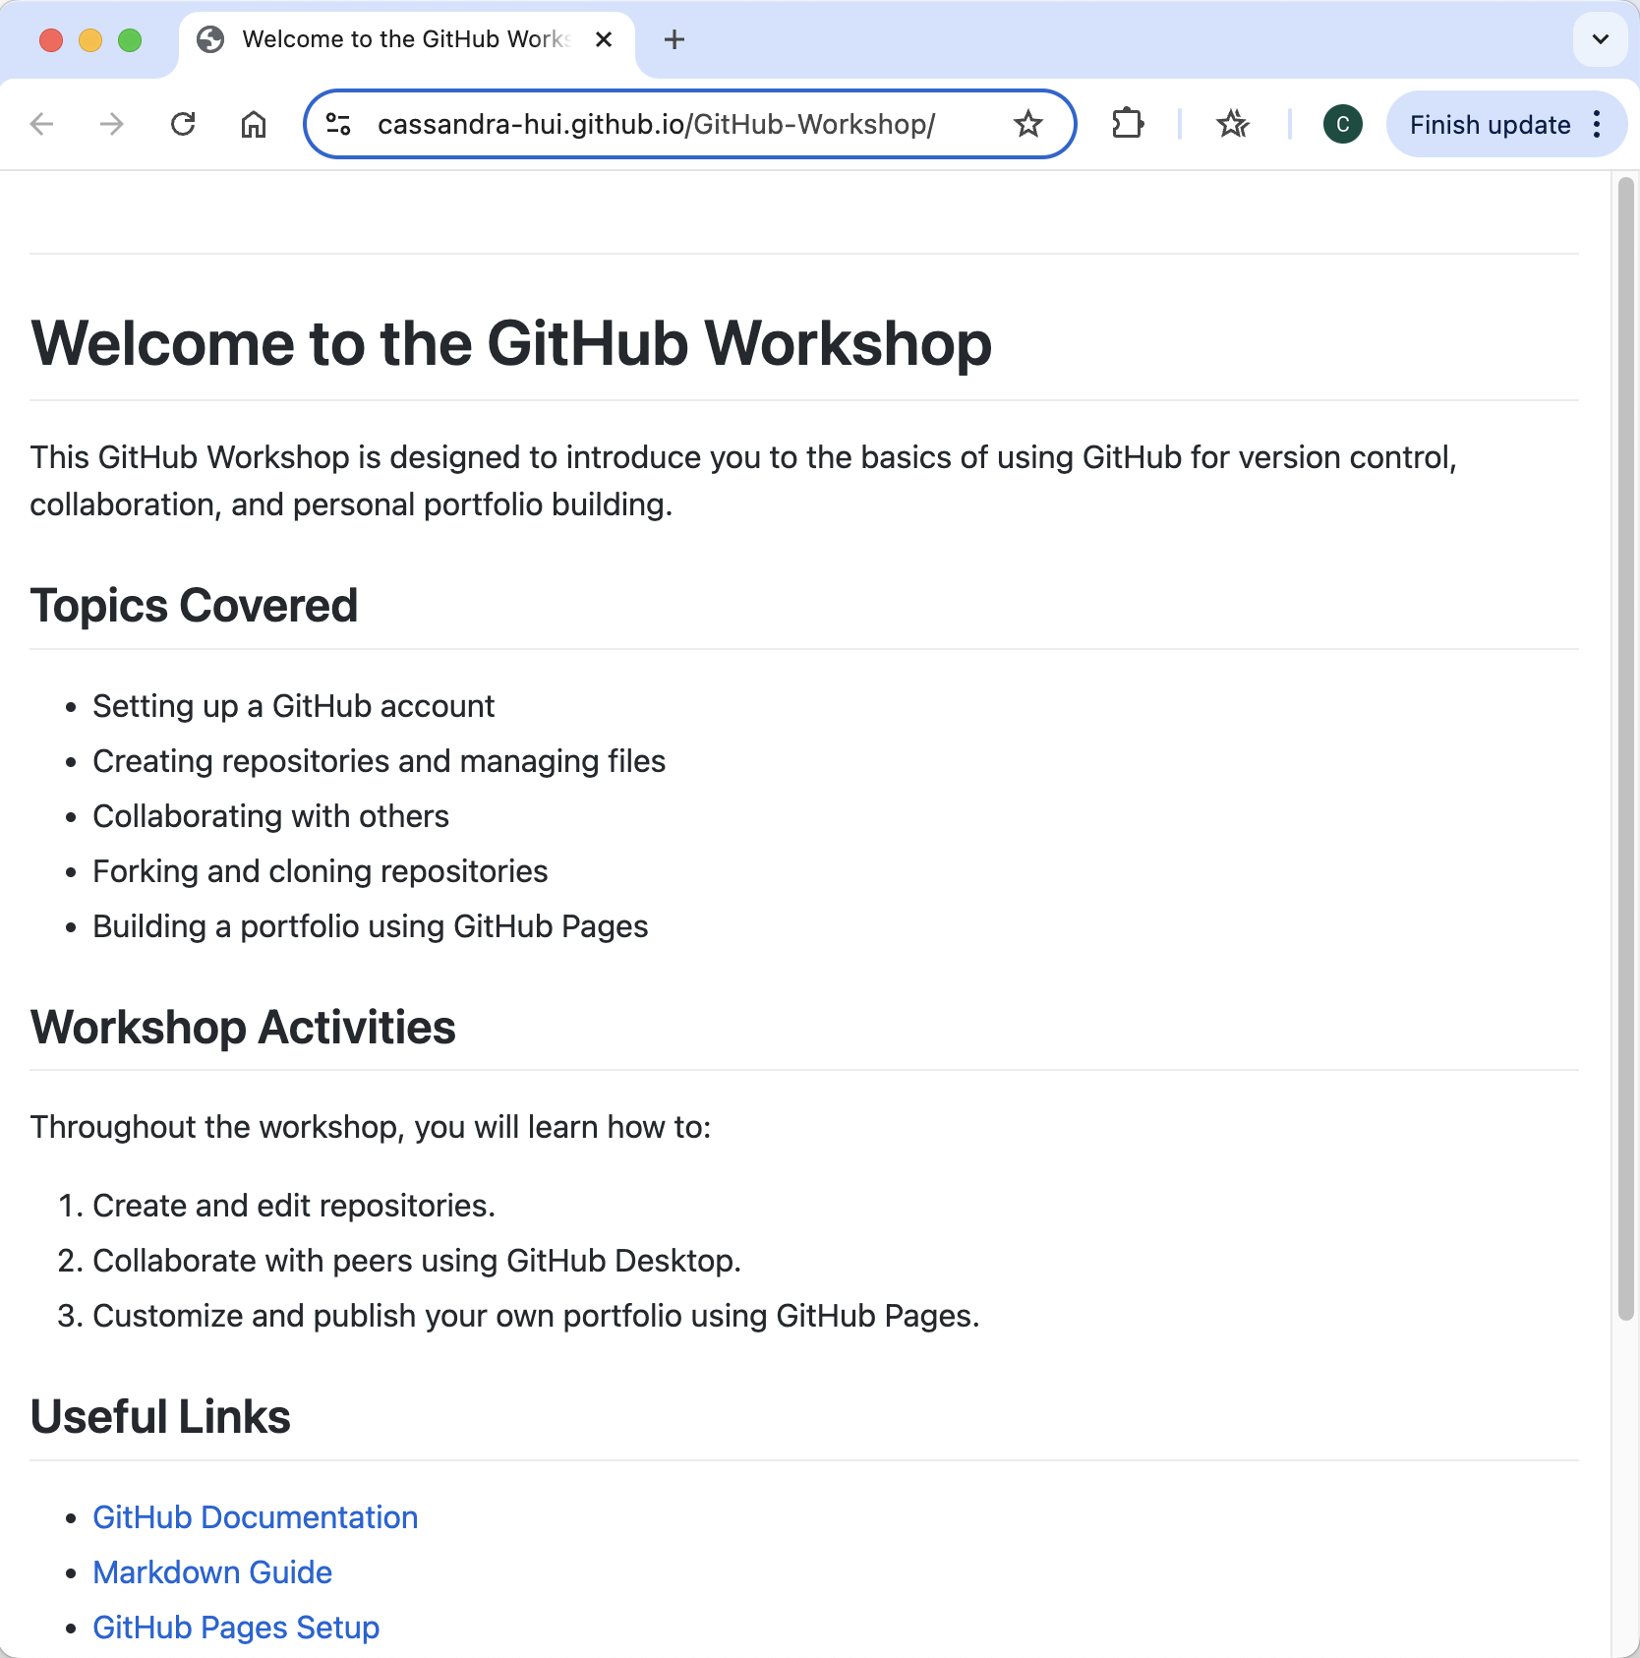
GitHub Pages
What Are GitHub Pages? GitHub Pages is a feature that allows you to host static websites directly from your GitHub repository. It’s often used for personal portfolios, project documentation, or blogs.
How to Enable GitHub Pages: Go to the repository’s Settings > Pages, select the branch and folder (e.g., main and /root), and click Save. Your site will be live at https://username.github.io/repository-name.
What Can You Publish? Websites created with Markdown or HTML, CSS, and JavaScript files. The starting page will be index.md or index.html.

Slide 34
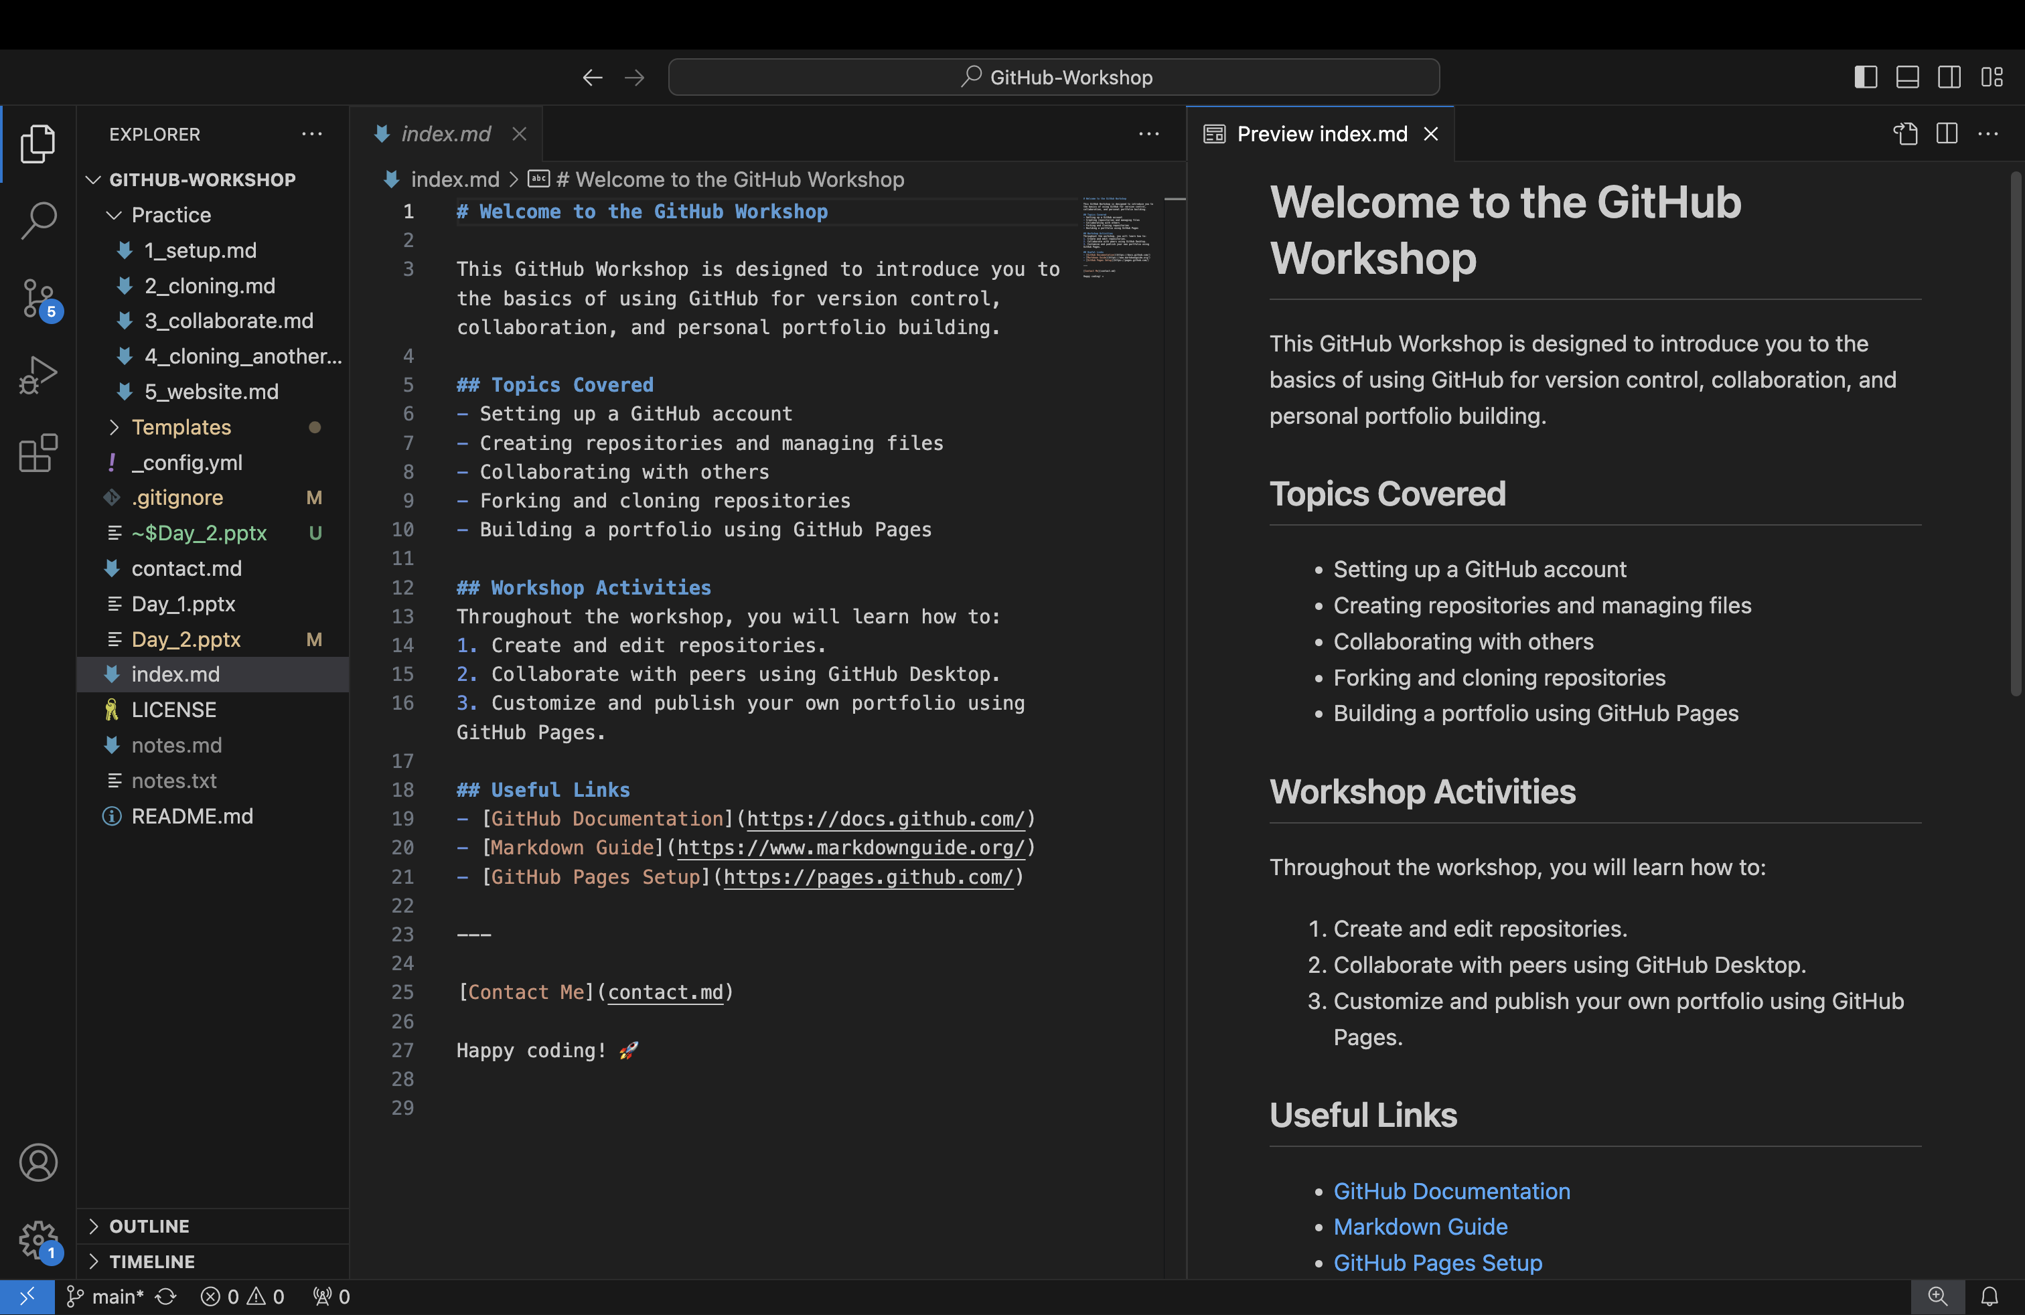
Markdown
You can make a complete GitHub Pages with Markdown

Slide 35
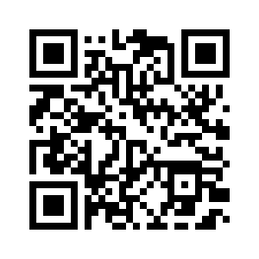
My GitHub Workshop Repository -GitHub Pages

Slide 36
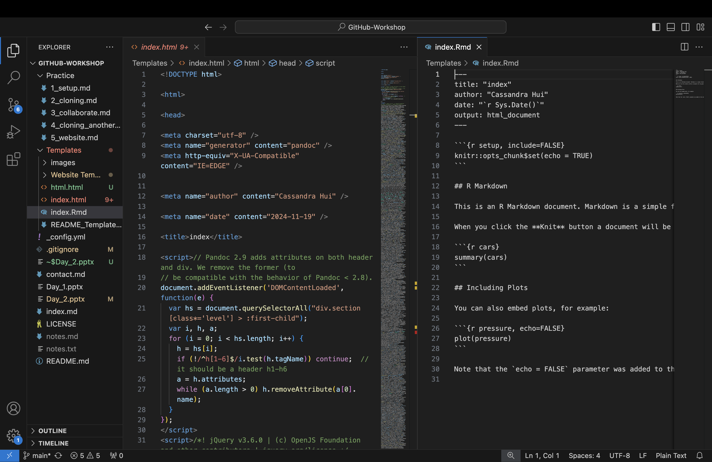
You can make GitHub Pages with HTML—For Example, by rendering an R markdown file.

Slide 37
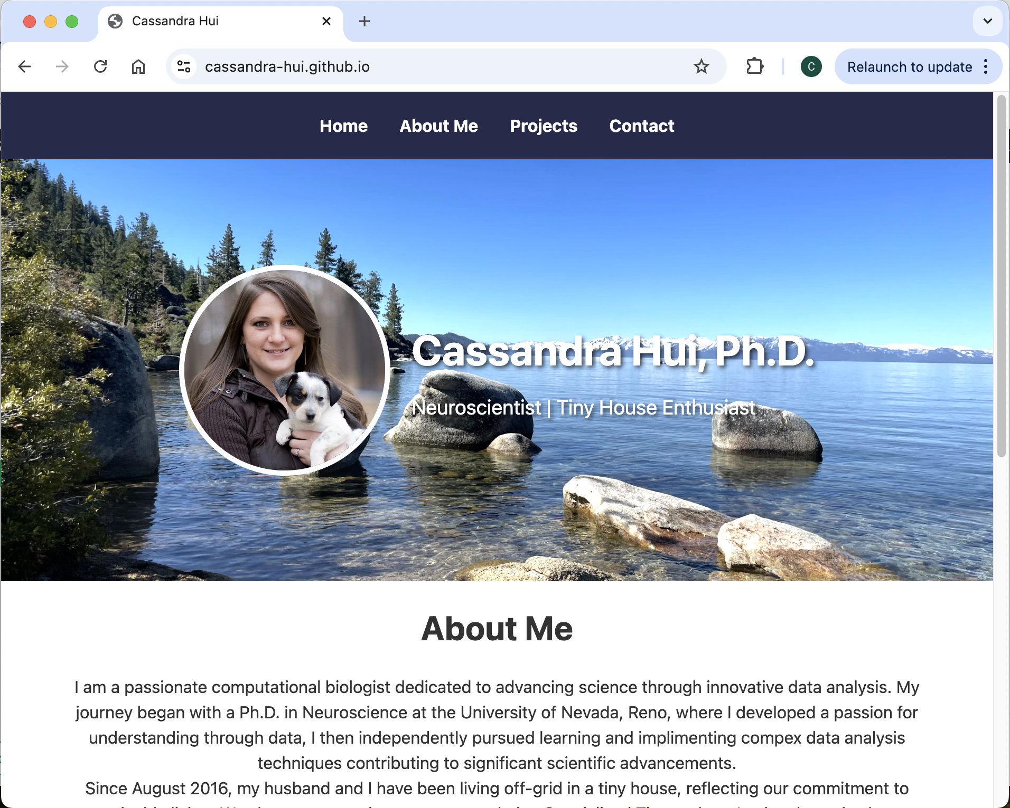
GitHub Website
What is a Personal Website on GitHub Pages?
A username.github.io repository hosts your personal website, which becomes accessible at https://username.github.io. It’s ideal for portfolios, resumes, or blogs.
How to Set It Up:
Create a new repository named username.github.io.
Add HTML, CSS, or Markdown files to design your website.
The site will automatically be published at https://username.github.io.

Slide 38
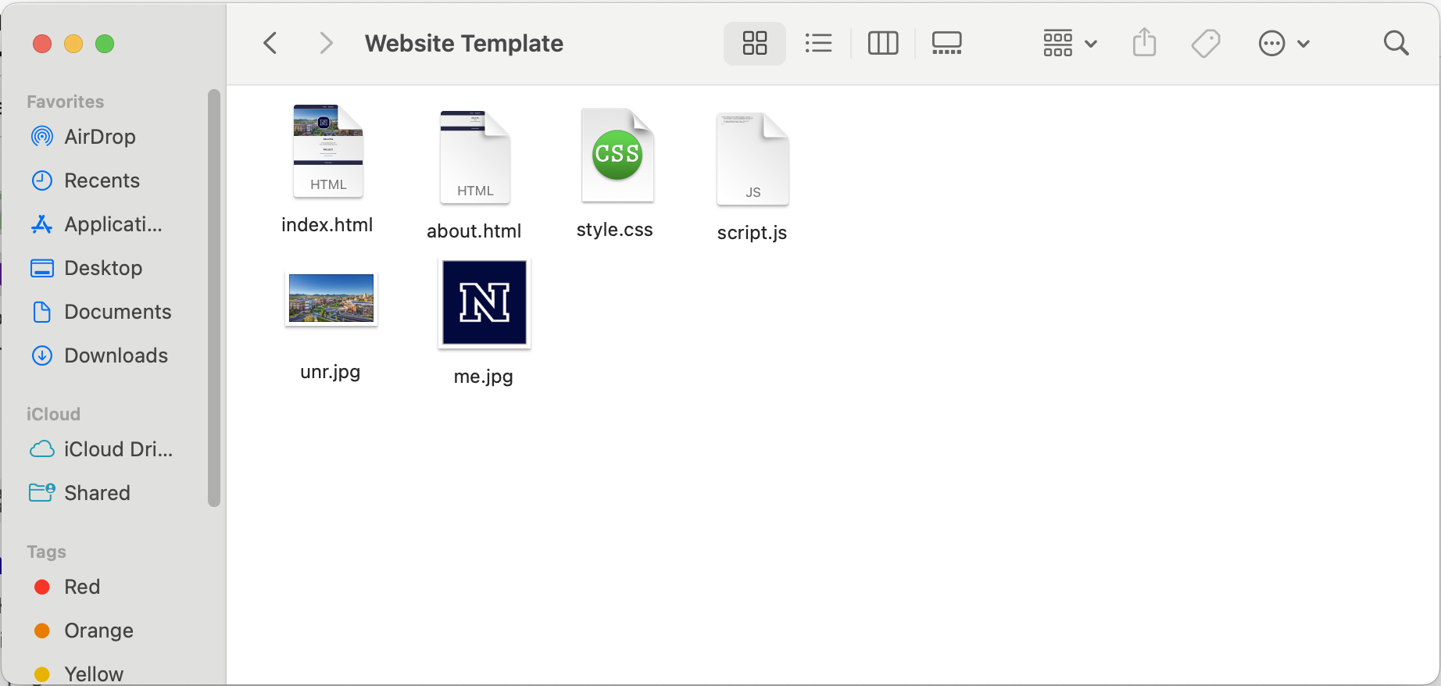
Template Files
I have provided some template files for you to edit to create your own website. Let’s go through the files.

Slide 39
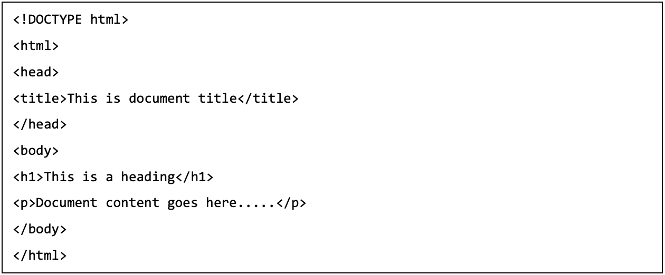
HTML files
Hypertext Markup Language (HTML) is a computer language that's used to structure and define the content of a web page.

Slide 40
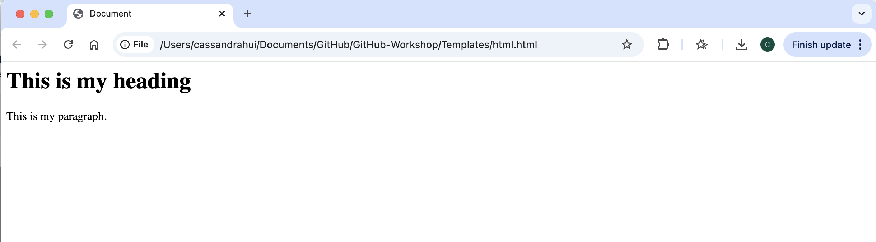

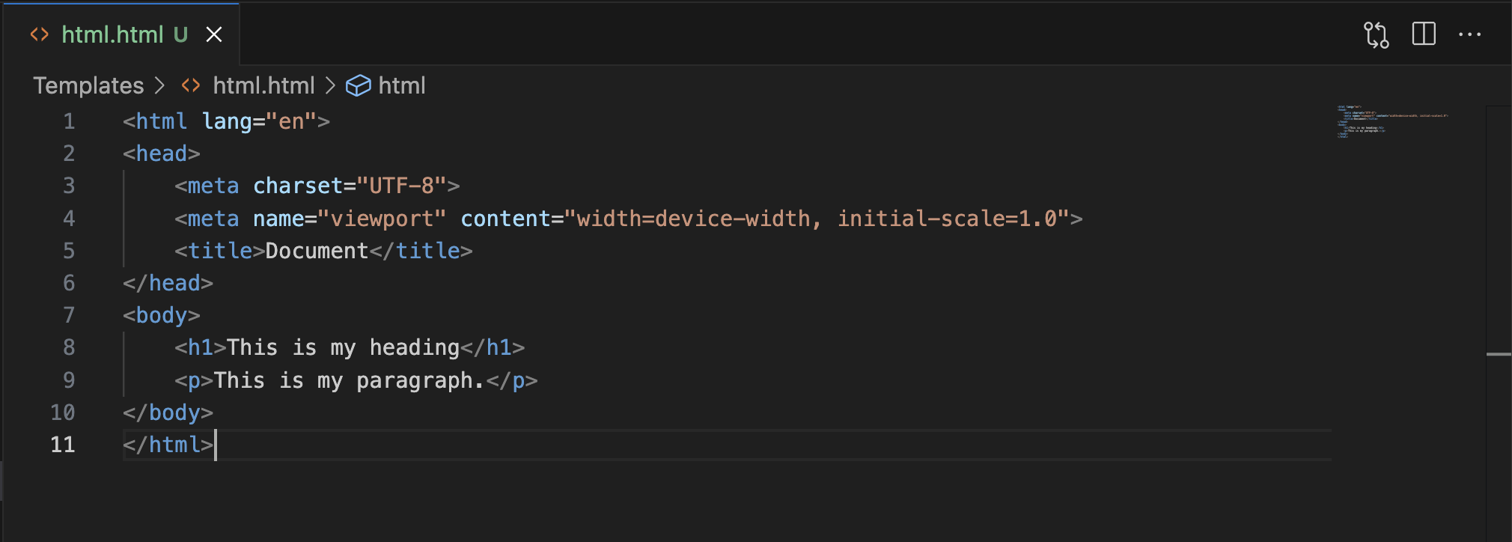


Slide 41
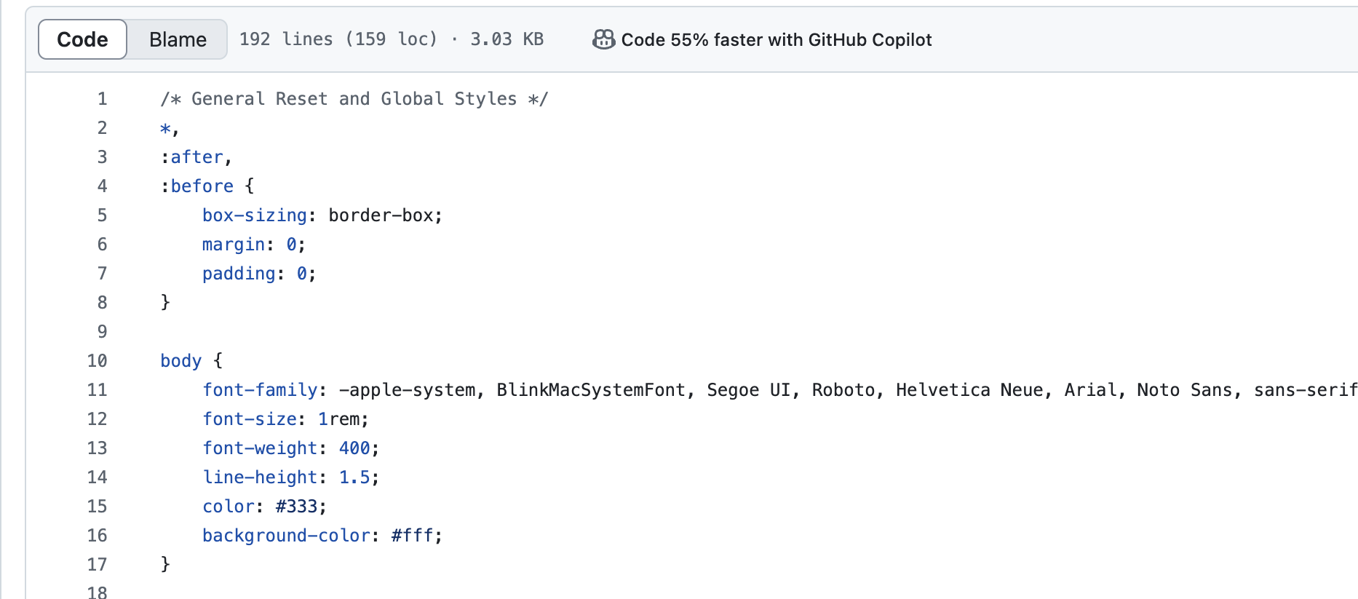
css
Cascading Style Sheets (CSS) is a style sheet language used for specifying the presentation and styling of a document written in a markup language such as HTML

Slide 42
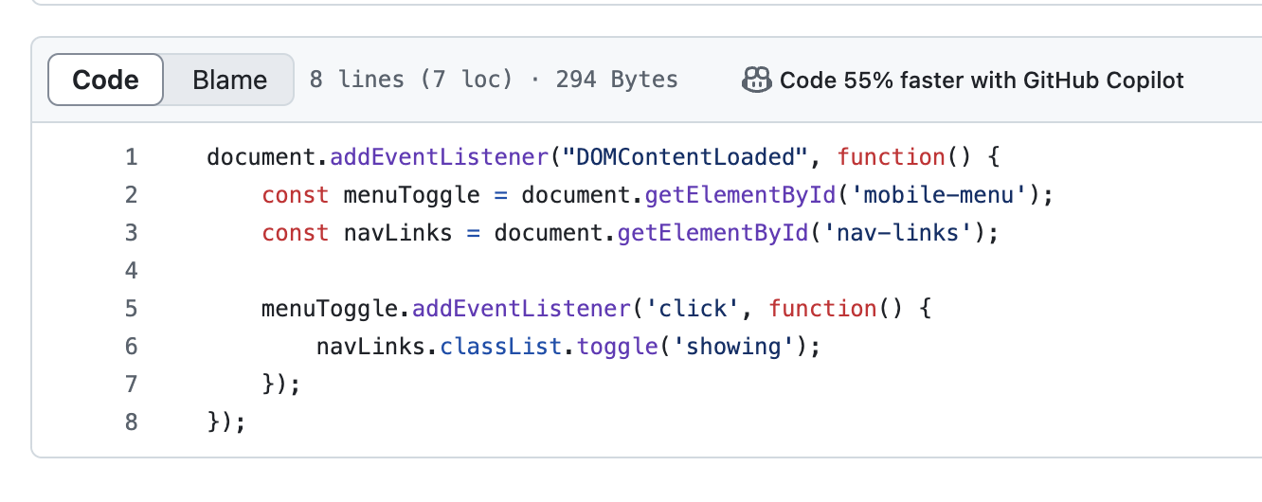
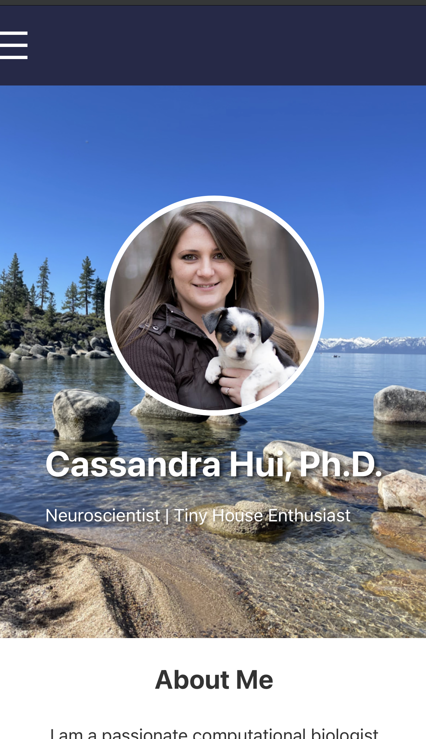

Script.js
JS (JavaScript) are files that contain JavaScript code for execution on web pages.
In this case we only have one code that causes the menu to fold into a “hamburger” style on a mobile device.

Slide 43
GitHub Pages
Follow the 5_website.md file in the Practice folder
Clone my repository
Copy and edit website template files
Publish your GitHub Pages website

Slide 44
Create a GitHub Page

Slide 45
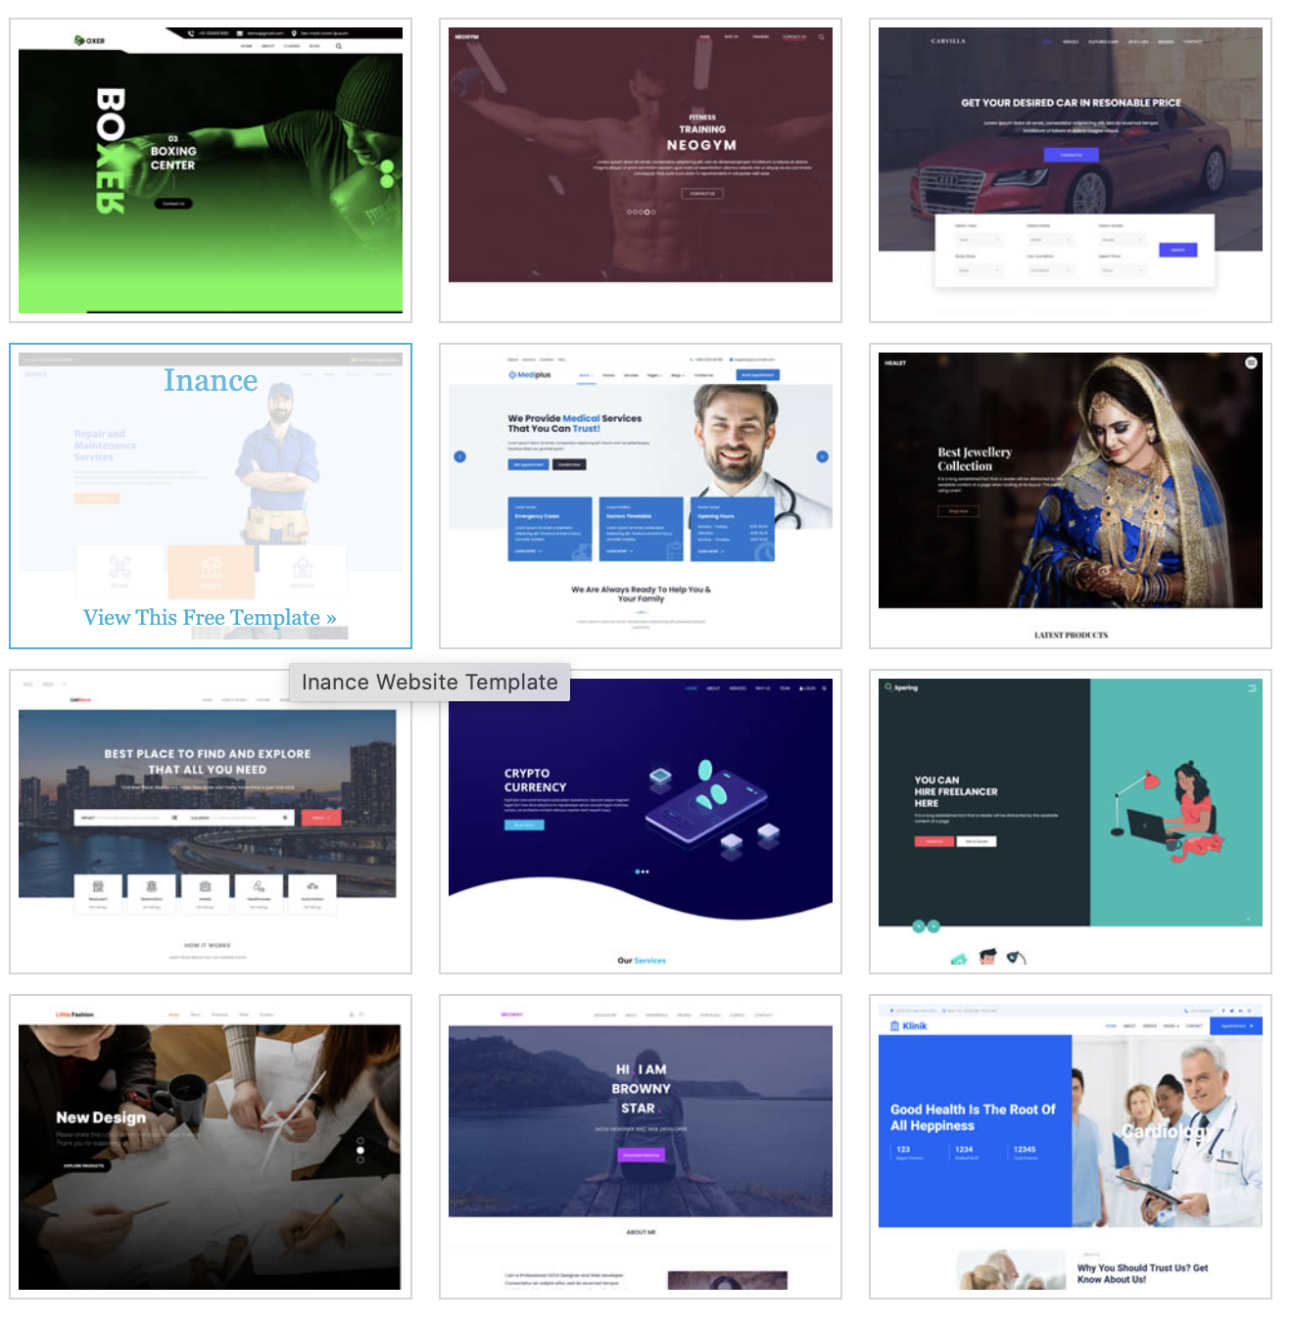

Templates
Look up templates for your websites
https://bulma.io/

Slide 46
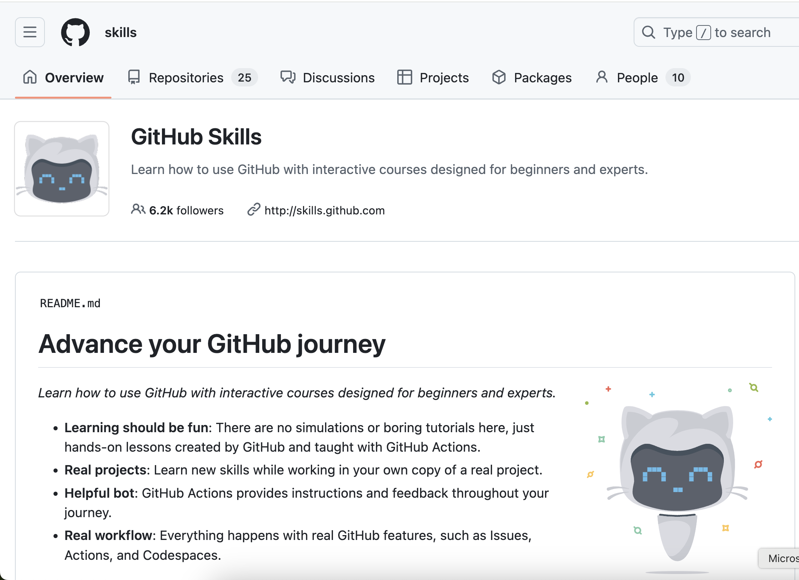
Learn More
https://github.com/skills

Slide 47
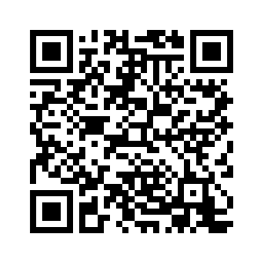
Survey

Slide 48
THANK YOU
References:
https://docs.github.com/en
https://git-scm.com/book/en/v2

